Slide 1
English 1
Week 4- Day 1

Slide 2
Objective:
Tell the number of syllables in given spoken words
LLKPA-Ig-8

Slide 4
REVIEW:
Multiple Choice: Write the letter of the best answer.
1. Which of the following pair of words have the same sound?
A. tall-ball C. hair-bed
B. move-dance D. wet-dry
A

Slide 5
REVIEW:
A
2. Hickory dickory dock. The mouse ran up the ________
A. clock C. dickory
B. mouse D. the

Slide 6
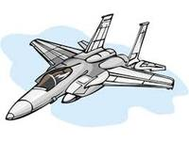
REVIEW:
B
3.Which word rhymes with jet?
A. kit
B. pet
C. hat
D. jug

Slide 7

Let’s watch this!

Slide 8

Let’s watch this!

Slide 9

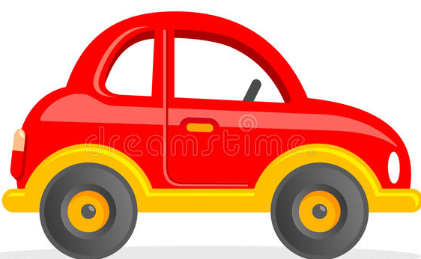
Look at the pictures and count the syllables of the word.
How many syllables does it have?
In the word car, it has 1 syllable.
car

Slide 10
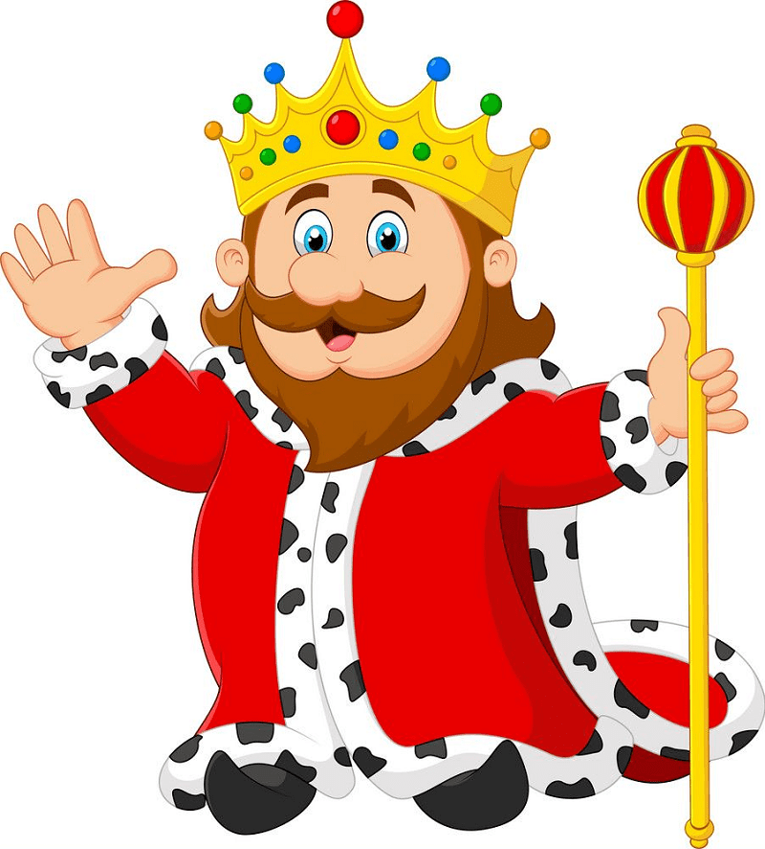
Look at the pictures and count the syllables of the word.
How many syllables does it have?
In the word king, it has 1 syllable.
king

Slide 11
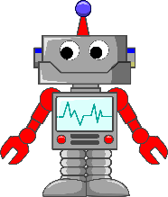
Look at the pictures and count the syllables of the word.
How many syllables does it have?
The word robot has 2 syllables.
ro-bot

Slide 12
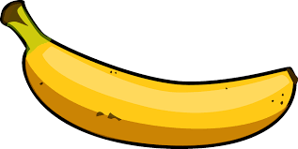
Look at the pictures and count the syllables of the word.
How many syllables does it have?
The word banana has 3 syllables.
ba-na-na

Slide 13
A syllable is a single, unbroken sound of a spoken (or written) word. Syllables usually contain a vowel and accompanying consonants.
Sometimes syllables are referred to as the ‘beats’ of spoken language.

Slide 14
Drill board: Write the number of syllables in each word.
1.pop-corn
2. class-room
3. Sad
4. Star
5. pla-net
2
2
1
1
2

Slide 15
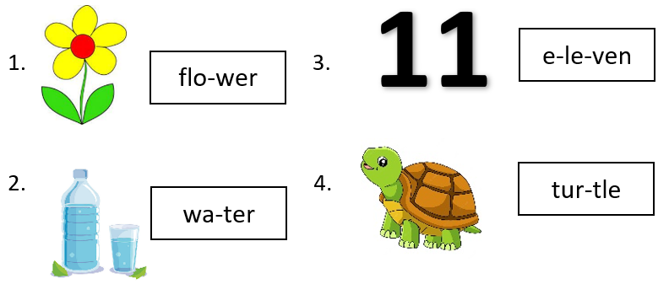
Clap how many syllables does the word have.

Slide 16
Count the number of syllables of each word and put them in the right column.
1- SYLLABLE | 2-SYLLABLES | 3-SYLLABLES
cap
letter
computer
one
picnic
banana
One banana computer
letter picnic cap

Slide 17
What have you learned today?
Remember:
The number of times you hear a vowel (a, e, i , o, u) in a word is equal to the number of syllables a word has. A good way to identify
syllables is to think about whether you need to change your mouth shape to say the next bit of the word / the new syllable.

Slide 18
Write the letter of the correct answer.
1. How many syllables does the word plant have?
A. 1 B. 3
2. The word Philippines has _____ syllables.
A. 3 B. 2
3. How many syllables does the word cat, dog
and pig have?
A. 2 B. 1

Slide 19
4. How many syllables does the word book have?
A. 1 B. 2
5. Letters Aa, Ee, Ii, Oo and Uu are called __________.
A. consonants B. vowels

Slide 20
ANSWERS:
1.A
2.A
3.B
4.A
5.B

